Slide 1
Software Process Models

Slide 2
Agile Methods
Emphasis on flexibility in producing software quickly and capably in rapidly changing environment
Market condition
End-user needs
Competitive threats
Process models can deal with software engineers frailty in 2 ways:
Discipline?
Tolerance?
Agile Methods, Chapter 05, SE Book by Pressman et al.

Slide 3
Agile Methods
Assumptions to be addressed:
Which requirements will persist/change? How will the customer priorities change?
The extent/amount of design work before coding and testing?
Planning of all engineering activities?
Adaptable?
Progress or no progress?
Incremental
Customer feedback
Portion of an operational system
Unpredictability

Slide 4
Agile Methods
Agile manifesto
Concentrate on responding to change rather than on creating a plan and then following it (chaordic)
Value individuals and interactions over process and tools
Prefer to invest time in producing working software rather than in producing comprehensive documentation
Focus on customer collaboration rather than contract negotiation

Slide 5
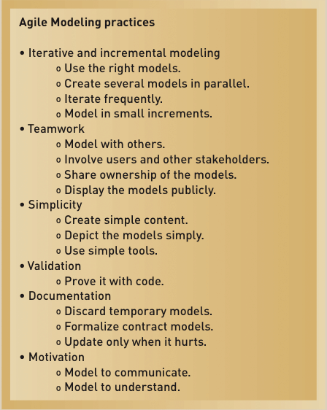
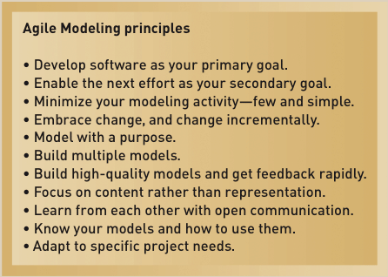
Agile Methods

Slide 6
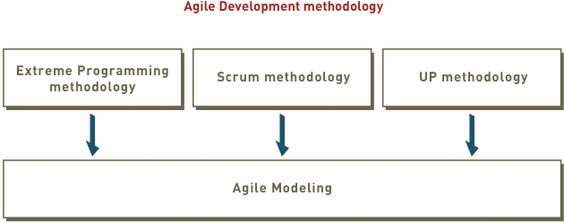
Agile Methods (Contd.)

Slide 7

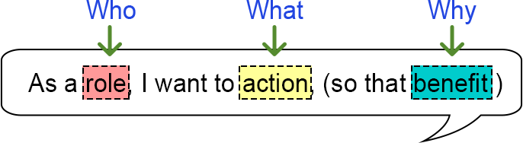
User Stories
As a [customer], I want [shopping cart feature] so that [I can easily purchase items online].
As a [manager], I want to [generate a report] so that [I can understand which departments need more resources].
As a [customer], I want to [receive an SMS when the item arrives] so that [I can go pick it up right away]

Slide 8
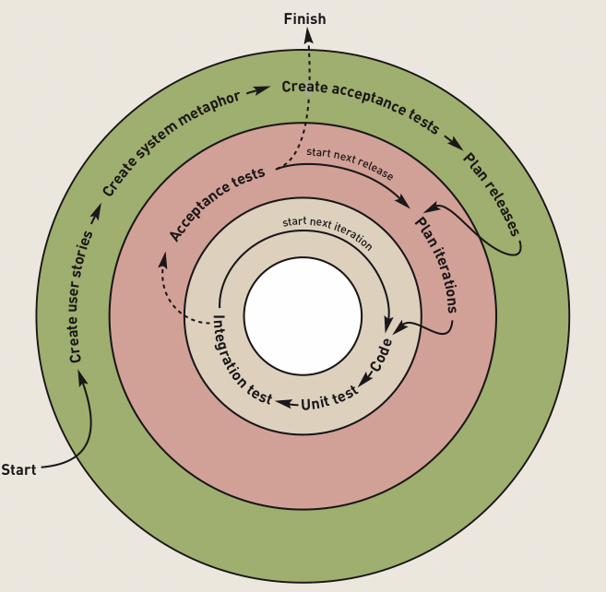
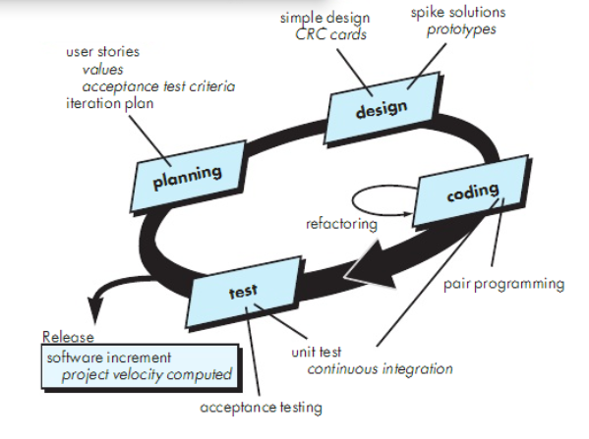
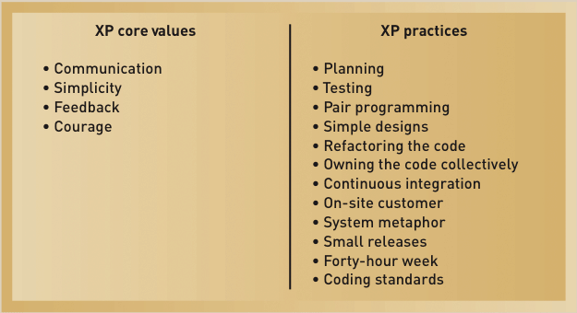
Agile Methods (Contd.)
Extreme Programming (XP)
XP Development Approach

Slide 9
Agile Methods (Contd.)
Scrum:
A quick, adaptive, and self-organizing development methodology
Responds to a current situation as rapidly and positively as possible

Slide 10
Agile Methods (Contd.)
Scrum Philosophy
Responsive to a highly changing, dynamic environment
Focuses primarily on the team level
Team exerts total control over its own organization and work processes
Uses a product backlog as the basic control mechanism
Prioritized list of user requirements used to choose work to be done during a Scrum project

Slide 11
Agile Methods (Contd.)
Scrum Organization
Product owner
The client stakeholder for whom a system is being built
Maintains the product backlog list and priorities
Scrum master
Person in charge of a Scrum project, leads meetings, assesses responses
Scrum team or teams
Small group of developers
Set their own goals and distribute work among themselves

Slide 12
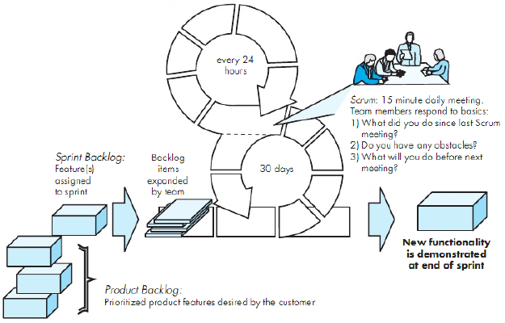
Scrum Process Flow

Slide 13
Agile Methods (Contd.)
Scrum Practices
Sprint
The basic work process in Scrum
A time-controlled mini-project
Firm 30-day time box with a specific goal or deliverable
Parts of a sprint
Begins with a one-day planning session
A short daily Scrum meeting to report progress
Ends with a final half-day review

Slide 14
Kanban Boards
Visual signal
Increase visibility
Components
Cards
Columns
WIP limits
Lead time (commitment point to delivery point)

Slide 15
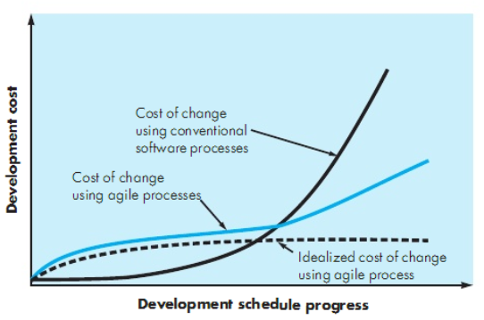
Cost of Change and Agile Methods

Slide 16
Agile Methods (Contd.)
Human Factors
Competence
Knowledge of the process
Common focus
Deliver a working s/w increment within promised time
Collaboration
Assess, analyze, use, create information
Decision making ability
autonomy
Fuzzy problem solving ability
Mutual trust and respect
Self organization
Itslef
Process
Work

Slide 17
Process Models (Recap)
Lifecycle Models
Classical Waterfall
With prototyping
V model
Incremental Models
Phased development in increments (Incremental Model)
Rapid Application Development (RAD)
Evolutionary Models
Prototyping model
Spiral model
Unified process
Agile methods
XP
Scrum
Kanban Boards

Slide 18
Software Engineering Principles
Provide value to customer
Design should be as simple as possible
Maintain a clear vision
Always specify design, implement accordingly so that others can understand
Software should be ready to adapt to changes
Plan ahead for reuse
Place clear, complete thought before action

Slide 19
?

Slide 20
References
SE, Pressman
SE, Pfleeger

